Slide 1







Control
Lec. 5
Stability of Control System
References:
Modern control Engineering by OGATA
Automatic control system by KUO.
Control system Engineering by Norman S. Nise.
http://imtiazhussainkalwar.weebly.com.
Stability is the most important system specification. If a system is unstable transient response and steady-state errors are moot points. An unstable system cannot be designed for a specific transient response or steady-state error requirement.
Transfer Function: The transfer function G(S) of the plant is ratio of Laplace transform of output to the Laplace transform of input considering initial conditions to zero.
U(S)
G(S)
Y(S)
Transfer function helps us to check:
The stability of the system
Time domain and frequency domain characteristics of the system
Response of the system for any given input
Transfer Function has the form:
Then,
Roots of denominator polynomial of a transfer function are called ‘poles’.

Slide 2


Control
Lec. 5
Roots of numerator polynomial of a transfer function are called ‘zeros’.
The poles and zeros of the system are plotted in s-plane to check the stability of the system.
jω
LHP
σ
s-plane
If all the poles of the system lie in left half plane the system is said to be Stable.
If any of the poles lie in right half plane the system is said to be unstable.
If pole(s) lie on imaginary axis the system is said to be marginally stable.
The location of a pole in the complex plane is denoted symbolically by a cross ( x), and the location of a zero by a small circle (0). The s-plane including the locations of the finite poles and zeros of F ( s ) is called the pole-zero map of F ( s ) . A similar comment holds for the z-plane.

Slide 3
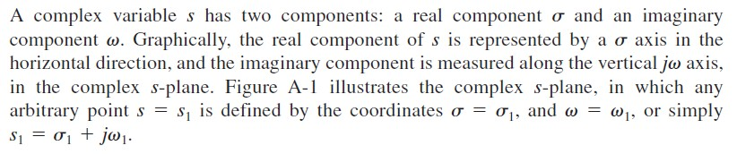
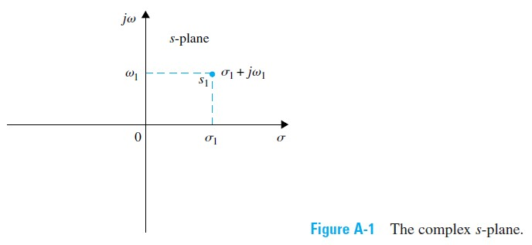
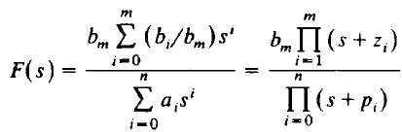


Control
Lec. 5
Complex-Variable Concept
COMPLEX PLANE POLEZERO MAPS:
The rational functions F ( s ) for continuous systems can be rewritten as
=T.F
where the terms s + zi are factors of the numerator polynomial and the terms s +p_{i}, are factors of the denominator polynomial.
EX 1: Let F ( s ) be given by

Slide 4
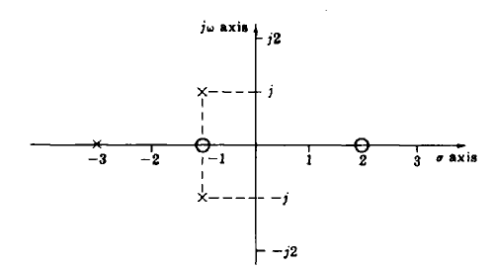


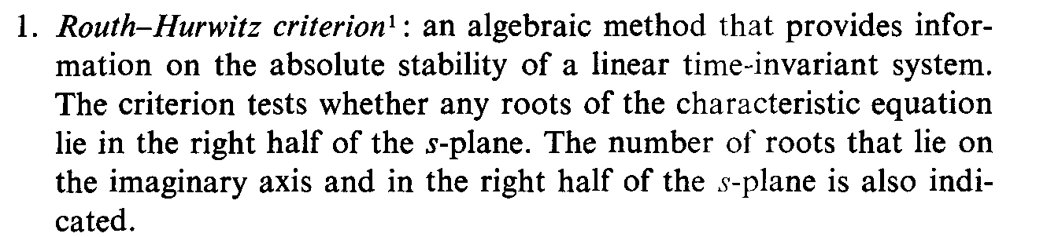
Control
Lec. 5
which can be rewritten as:
F ( s ) has finite zeros at s = - 1 and s = 2. F(s) has finite poles at s = - 3, s = - 1 - j , and s = - l+j. The pole-zero map of F ( s ) is shown in Fig. below
There are two kinds of stability definitions in control system study.
Absolute Stability:
Relative Stability:
Methods of determining stability

Slide 5
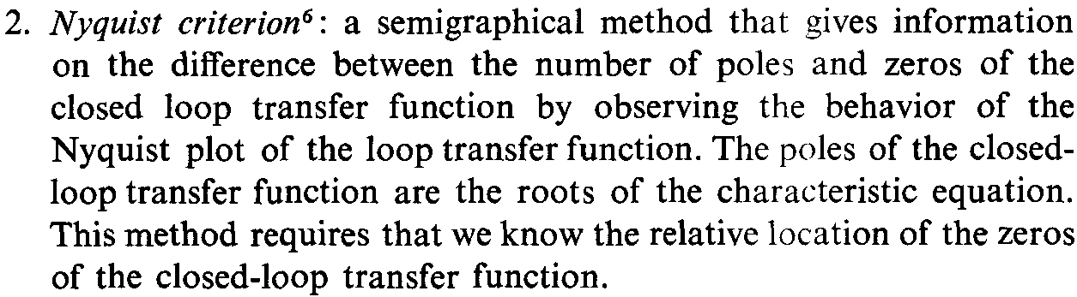
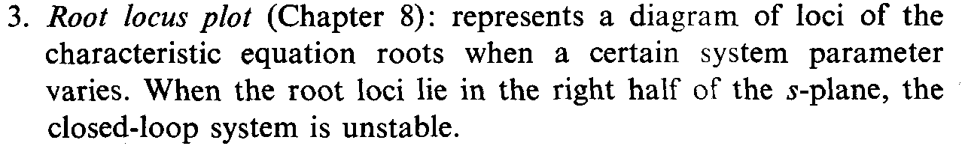
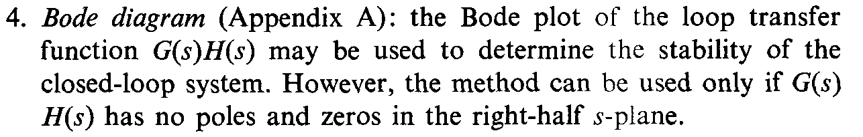
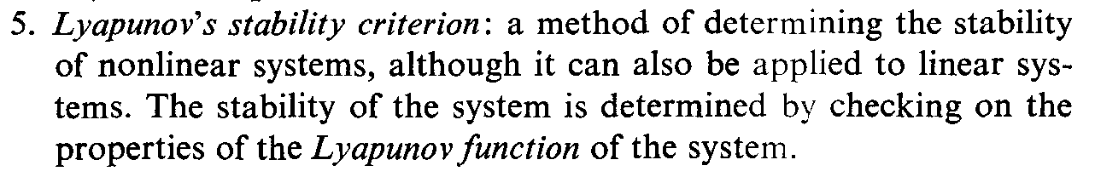
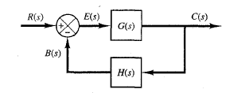
Control
Lec. 5
Characteristic Equation:
It is the equation formed by putting the denomenter of the T.F of the system equal to zero.
( )
( )
( ) ( ) ( )
The Characteristic Equation (C.E) of the system is given by:
1+ G(s)H (s) = 0
Most linear closed-loop systems have closed-loop transfer functions of the form:

Slide 6

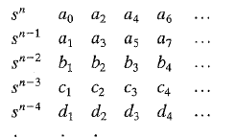
Control
Lec. 5
A simple criterion, known as Routh's stability criterion, enables us to determine the number of closed-loop poles that lie in the right-half s plane without having to factor the denominator polynomial.
Routh's Stability Criterion:
Routh's stability criterion tells us whether or not there are unstable roots in a polynomial equation without actually solving for them. This stability criterion applies to polynomials with only a finite number of terms. When the criterion is applied to a control system, information about absolute stability can be obtained directly from the coefficients of the characteristic equation. The procedure in Routh's stability criterion is as follows:
1. Write the polynomial in s in the following form:
where the coefficients are real quantities. We assume that a_{n} ≠ 0; that is, any zero root has been removed.
If any of the coefficients are zero or negative in the presence of at least one positive coefficient, there is a root or roots that are imaginary or that have positive real parts.
Therefore, in such a case, the system is not stable.
If all coefficients are positive, arrange the coefficients of the polynomial in rows and columns according to the following pattern:

Slide 7
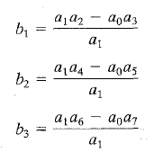
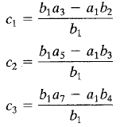

Control Lec. 5
The process of forming rows continues until we run out of elements. (The total number of rows is n + 1.) The coefficients b1, b2, b3, and so on, are evaluated as follows:
Then continue solve for b₄ and b₅ in the same way until we obtain zero. The same pattern of cross- multiplying the coefficients of the two previous rows
The table is continued horizontally and vertically until only zeros are obtained. Any row can be multiplied by a positive constant before the next row is computed without disturbing the properties of the table.
If all the constants in the first column have the same sign (positive or negative) then, the system is stable.
If the first column have (positive and negative) then, the system is unstable.
If one of these values equal to zero then the system is critical and the value of critical amplifier gain can be obtained accordingly.
EX 1: apply Routh's stability criterion to the following third-order polynomial:

Slide 8
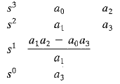

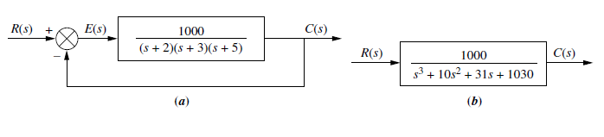
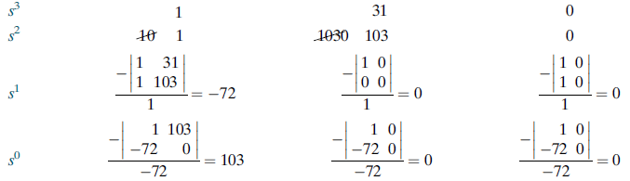
Control
Lec. 5
where all the coefficients are positive numbers. The array of coefficients becomes:
The system will be stable if
Ex 2: Make the Routh table for the system shown in Figure (a).
SOL: The first step is to find the equivalent closed-loop system because we want to test the denominator of this function, not the given forward transfer function, for pole location. Using the feedback formula, we obtain the equivalent system of Figure (b).
Ex 3: Find the range of gain, K, for the system of Figure below that will cause the system to be stable, unstable, and marginally stable. Assume K > 0.

Slide 9
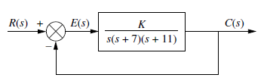

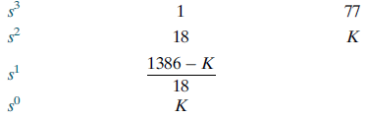
Control
Lec. 5
SOL: First find the closed-loop transfer function as:
Next form the Routh table shown as Table below
Since K is assumed positive, we see that all elements in the first column are always positive except the s1 row. This entry can be positive, zero, or negative, depending upon the value of K. If K < 1386, all terms in the first column will be positive, then, the system be stable.
If K > 1386, the s1 term in the first column is negative then, the system be unstable.
If K =1386, we have an entire row of zeros. Then, the system is marginally stable
Ex 4: determine the range of K for stability in Figure below.

Slide 10
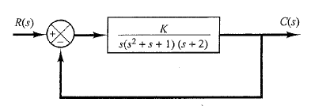


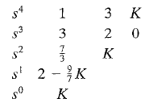

Control
Lec. 5
Sol: The closed-loop transfer function is
The characteristic equation is
The array of coefficients becomes
For stability, K must be positive, And all coefficients in the first column must be positive. Therefore,
Page 10

Slide 11

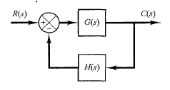
Control
Lec. 5
Root Locus Method-introduction
The relative stability and the transient performance of a closed loop system are directly related to the location of the closed-loop roots of the characteristic equation in the s-plane. It is frequently necessary to adjust one or more system parameters in order to obtain suitable root location.
It is useful to determine the locus of roots in s-plane as a parameter varied since the roots is a function of the system’s parameter. The root locus technique is a graphical method for
sketching the locus of roots in the s-plane as a parameter is varied and has been utilized extensively in control engineering practice. It provides the engineer with a measure of the sensitivity of roots of the system a variation in parameter being considered. The root locus technique may be used to great advantage in conjunction with the Routh-Hurwitz criterion.
Root Locus Method Developed by Evans while he was a graduate student at UCLA. In designing a linear control system, we find that the root-locus method proves quite useful since it indicates the manner in which the open-loop poles and zeros should be modified so that the response meets system performance specifications. This method is particularly suited to obtaining approximate results very quickly.
General Rules for Constructing Root Loci
We shall now summarize the general rules and procedure for constructing the root loci of the system shown in Figure below. First, obtain the characteristic equation:

Slide 12
Control
Lec. 5
1.
Locate the poles and zeros o f G(s)H (s) on the s plane. The root-locus branches start from open-loop poles and terminate at zeros (finite zeros or zeros at infinity). Determine No. of loci of the plot is equal to the order of C. E
Determine the root loci on the real axis. Root loci on the real axis are determined by open-loop poles and zeros lying on it. The complex-conjugate poles and zeros of the open-loop transfer function have no effect on the location of the root loci on the
2.
3.
real axis because the angle contribution of a pair of complex-conjugate zeros is 360" on the real axis.
Determine the asymptotes of root loci.
poles or
4.
Angle of asymptotes =ψ = ^{± 180°(2k + 1)}
n − m
where
n-----> number of poles
m-----> number of zeros For this Transfer Function
G s H s
K
( ) ( ) =
s(s +1)(s + 2)
_{ψ =} ±180°(2k +1)
3 − 0
the number of distinct asymptotes is n – m
5.
Determine Point of intersection of asymptotes on real axis (or centroid of asymptotes) can be find as out
_{σ =} ∑ poles − ∑ zeros
n − m
Ex: Determine the asymptotes of the root loci.

Slide 13
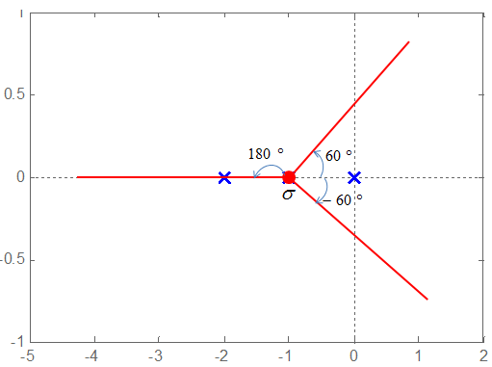
Control
Lec. 5
For
G(s)H (s) =
K
s(s +1)(s + 2)
_{σ =} (0 −1 − 2) − 0
3 − 0
σ = ⁻ ³ = −1 3
ψ = 60° ,−60° ,180°
Find the breakaway and break-in points.
  The breakaway point corresponds to a point in the s plane where multiple roots of the characteristic equation occur. It is the point from which the root locus branches leaves real axis and enter in complex plane.
  The break-in point corresponds to a point in the s plane where multiple roots of the characteristic equation occur. It is the point where the root locus branches arrives at real axis.
The breakaway or break-in points can be determined from the roots of
dK
ds
= 0
It should be noted that not all the solutions of dK/ds=0 correspond to actual breakaway points.
If a point at which dK/ds=0 is on a root locus, it is an actual breakaway or break-in point.
➢
Stated differently, if at a point at which dK/ds=0 the value of K takes a real positive
value, then that point is an actual breakaway or break-in point.
Ex: Determine the breakaway point or break-in point.

Slide 14

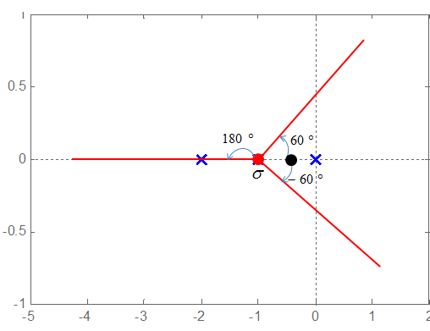
Control
Lec. 5
G(s)H (s) =
K
s(s +1)(s + 2)
The characteristic equation of the system is
1+ G(s)H (s) = 1+
K
= 0
s(s +1)(s + 2)
K
= −1
s(s +1)(s + 2)
K = −[s(s +1)(s + 2)]
The breakaway point can now be determined as
^{dK} = − ^{d} [s(s +1)(s + 2)] = 0
ds ds
s = −0.4226
= −1.5774
In fact, evaluation of the values of K corresponding to s=–0.4226 and s=–1.5774 yields
s = −0.4226
7.
Determine the points where root loci cross the imaginary axis.

Slide 15
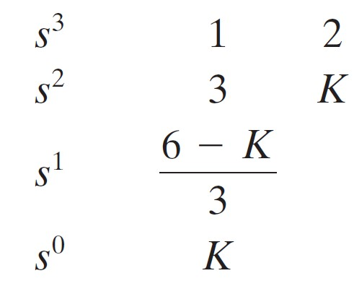


Control Lec. 5
The points where the root loci intersect the jw axis can be found easily by:
use of Routh's stability criterion
letting s = jw in the characteristic equation, equating both the real part and the imaginary part to zero, and solving for w and K. The values of w thus found give the frequencies at which root loci cross the imaginary axis. The K value corresponding to
each crossing frequency gives the gain at the crossing point.
EX: Determine the points where root loci cross the imaginary axis for C. E below:
s³ + 3s² + 2s + K = 0
Sol: first method:
The Routh Array Becomes
The value(s) of K that makes the system marginally stable is 6.
The crossing points on the imaginary axis can then be found by solving the auxiliary equation obtained from the s² row, that is,
Which yields
Second method

Slide 16
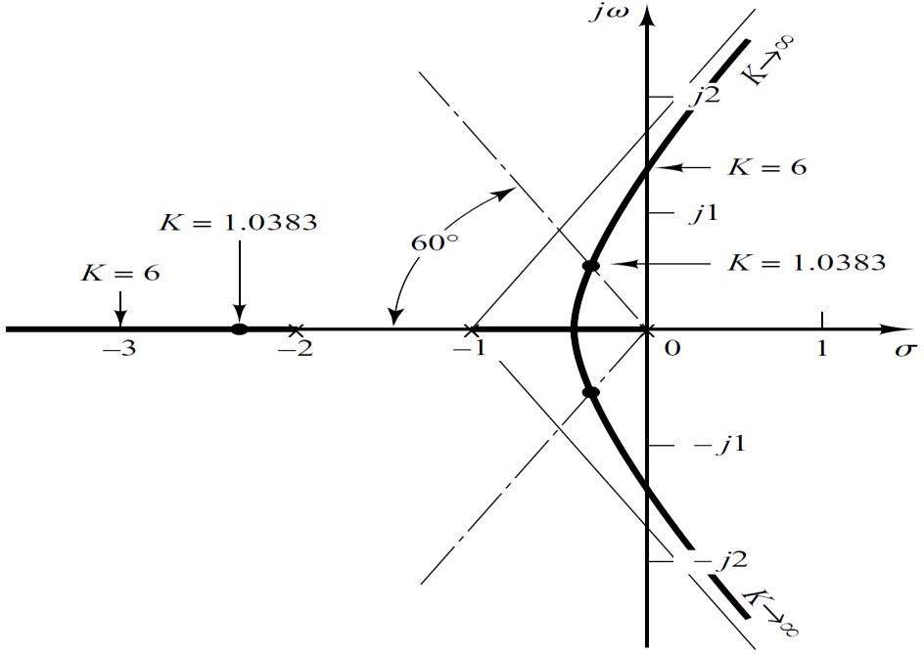






Control Lec. 5
An alternative approach is to let s=jω in the characteristic equation, equate both the real part and the imaginary part to zero, and then solve for ω and K.
For present system the characteristic equation is
s³ + 3s² + 2s + K = 0
( jω)³ + 3( jω)² + 2 jω + K = 0
(K − 3ω² ) + j(2ω −ω³ ) = 0
(K − 3ω² ) + j(2ω −ω³ ) = 0
Equating both real and imaginary parts of this equation to zero
(2ω −ω³ ) = 0
(K − 3ω² ) = 0
Which yields

Slide 17
Control
Lec. 5
8.
Determine the angle of departure (angle of arrival) of the root locus from a complex pole (at a complex zero). To sketch the root loci with reasonable accuracy, we must find the directions of the root loci near the complex poles and zeros. If a test point is chosen and moved in the very vicinity of a complex pole (or complex zero), the sum of the angular contributions from all other poles and zeros can be considered to remain the same. Therefore, the angle of departure (or angle of arrival) of the root locus from a complex pole (or at a complex zero) can be found by subtracting from 180" the sum of all the angles of vectors from all other poles and zeros to the complex pole (or complex zero) in question, with appropriate signs included.
Angle of departure from a complex pole=180 - (sum of the angles of vectors to a complex pole in question from other poles) + (sum of the angles of vectors to a complex pole in question from zeros)
Angle of arrival at a complex zero = 180 - (sum of the angles of vectors to a complex zero in question from other zeros) + (sum of the angles of vectors to a complex zero in question from poles)

Slide 18
Control
Lec. 5
Ex1: sketch the root locus of second order equation
( ) ( )
( )
( )( )
Sol:
1.We have two poles: p1=-1 , p2=-2
We have one zero z1=-4 m=1
n=2
2. the number of distinct asymptotes is n – m=2-1=1
3.
Angle of asymptotes =ψ = ^{± 180°(2k + 1)}
= 180
n − m
4.
_{σ =} ∑ poles − ∑ zeros ₌ − 2 −1 ₌ − 3 ₌ ₋₃
n − m 1 1
5. breakaway point or break-in point.
( ) ( )
1 + G(s)H (s) = 1 +
K (s + 4)
= 0
(s + 1)(s + 2)
[(s +1)(s + 2)]+ k(s + 4) = 0
⎡(s +1)(s + 2) ⎤
⎡
² + 3S + 2⎤
K = −⎢
⎥ = −⎢ ^{S}
⎥
⎥⎦
⎣
(s + 4)
⎦ ⎢⎣
S + 4
⎢ (S + 4)(2S + 3) − (_{S} + 3S + 2) ⎥
dK ds
⎡
2
⎤
=
⎢
⎣
(S +4)
2
= 0
⎥
⎦

Slide 19
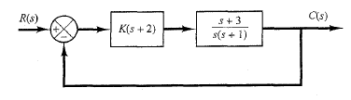
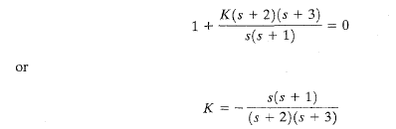
Control
Lec. 5
2s² +11s +12 − s² − 3s − 2 = 0
s² + 8s +10 = 0
s = −1.55, ors = −6.45
8
6
4
2
0
-2
-4
-6
-8
-8
-6
-4
-2
0
2
4
6
8
Ex 2: Sketch the root loci of the control system shown in Figure below.
Solution:
The procedure for plotting the root loci is as follows:
Locate the open-loop poles and zeros on the complex plane. Root loci exist on the negative real axis between 0 and -1 and between -2 and -3.
The number of open-loop poles and that of finite zeros are the same. This means that there are no asymptotes in the complex region of the s plane.
Determine the breakaway and break-in points. The characteristic equation for the system is

Slide 20
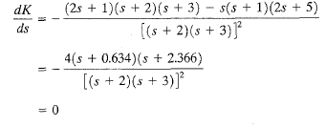

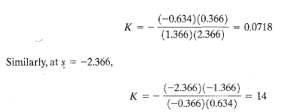
Control
Lec. 5
The breakaway and break-in points are determined from
as follows:
Notice that both points are on root loci. Therefore, they are actual breakaway or break-in points. At point s = -0.634, the value of K is
Because point s = -0.634 lies between two poles, it is a breakaway point, and because point
s = -2.366 lies between two zeros, it is a break-in point.)
Page 20

Slide 21
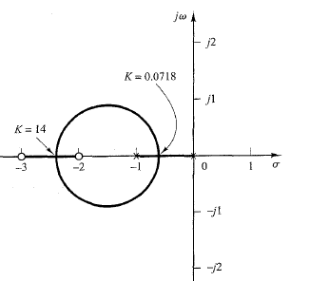
Control
Lec. 5
Ex 3: Sketch the root loci of ( ) ( )
( )
( )( )
We have two poles: p1=-3 , p2=-1+j, p3=-1-j We have one zero z1=-2 m=1
the number of distinct asymptotes is n – m=3-1=2
n=3
3.
Angle of asymptotes =ψ = ^{± 180°(2k + 1)}
=
n − m
4.
_{σ =} ∑ poles − ∑ zeros ₌ − 3 −1 + j −1 − j + 2 ₌ − 3 _{= −1.5}
n − m 3 −1 2
Frequency-Response Methods and Stability
The frequency response of a system is defined as the steady-state response of the system to a sinusoidal input signal. The sinusoid is a unique input signal, and the resulting output signal for a linear system, as well as signals throughout the system, is sinusoidal in the steady-state. Frequency-response methods were developed in 1930s and 1940s by Nyquist,

Slide 22
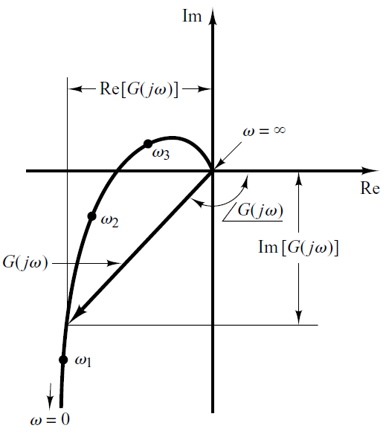
Control Lec. 5
Bode, Nichols, and many others. The frequency-response methods are most powerful in conventional control theory. They are also indispensable to robust control theory
Presenting Frequency-Response Characteristics in Graphical Forms:
The sinusoidal transfer function, a complex function of the frequency w, is characterized by its magnitude and phase angle, with frequency as the parameter. There are three commonly used representations of sinusoidal transfer functions:
Bode diagram or logarithmic plot
Nyquist plot or polar plot
Log-magnitude-versus-phase plot (Nichols plots)
1. Polar Plots
The polar plot of a sinusoidal transfer function G(jω) is a plot of the magnitude of G(jω) versus the phase angle of G(jω) on polar coordinates as ω is varied from zero to infinity. Thus, the polar plot is the locus of vectors | ( )| ( ) as ω is varied from zero to infinity.
Polar Plot

Slide 23
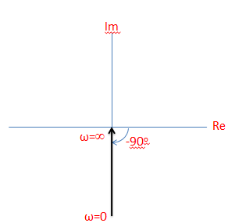
Control Lec. 5
Each point on the polar plot of G(jω) represents the terminal point of a vector at a particular value of ω. The projections of G(jω) on the real and imaginary axes are its real and imaginary components.
the frequency response can be calculated by replacing s in the transfer
jw.
It will also be shown that the steady-state response can be given by
function by
G(jω)= , where R is the amplitude ratio of the output and input sinusoids and
is the phase shift between the input sinusoid and the output sinusoid
Nyquist Stability Plot must be a closed contour
Procedure of Nyquist Plot
1. express the magnitude and phase equations in terms of w
Estimate the magnitude and phase for different values of w
Plot the curve and determine required performance metrics
Transfer Function Component Representation:
The polar plot of G(jω)=1/jω is the negative imaginary axis, since
G( jω) =
1
jω
In polar form G( jω) = ¹ ∠ − 90□
ω
The polar plot of G(jω)=jω is the positive imaginary axis, since
G( jω) = jω

Slide 24
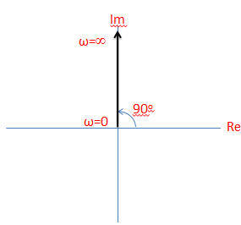
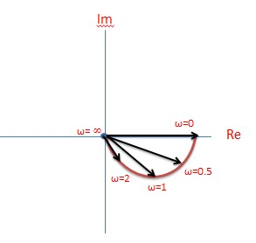
Control
Lec. 5
In polar form G( jω) = ω∠90□
For the sinusoidal transfer function
G( jω) =
1
jω +1
ω
G( jω) (R)
∠G( jω)(Φ)
0
1
₀o
0.5
0.9
-26º
1
0.7
-45º
2
0.4
-63º
∞
0
-90
The graph for above example is the mirror image about the diameter of this semicircle. It is
shown in Fig below by a dashed line.

Slide 25
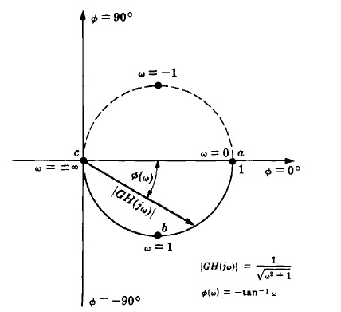
Control
Lec. 5
Example1: Draw the polar plot of following open loop transfer function.
G(s) =
1
s(s + 1)
SOL:
1
Put s = jω
G( jω) =
jω( jω +1)
G( jω) =
1
1 − ω² − jω
− ω² + jω
G( jω) =
×
− + jω − − j
_{ω}2
_{ω}2
ω
G( jω) =
− ω² − jω
G( jω) =
− ω²
− j
ω
ω⁴ + ω²
ω⁴ + ω²
ω⁴ + ω²
G( jω) =
−1
− j
1
ω ² +1
ω(ω ² +1)

Slide 26
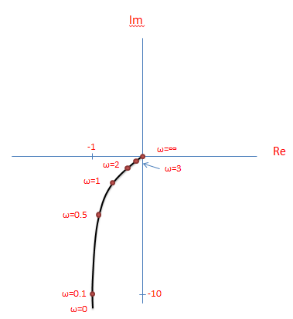
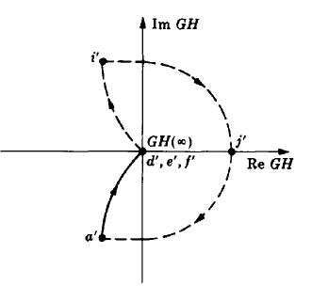
Control
Lec. 5
ω
Re
Im
0
∞
∞
0.1
-1
-10
0.5
-0.8
-1.6
1
-0.5
-0.5
2
-0.2
-0.1
3
-0.1
-0.03
∞
0
0

Slide 27
Control
Lec. 5

